Slide 1
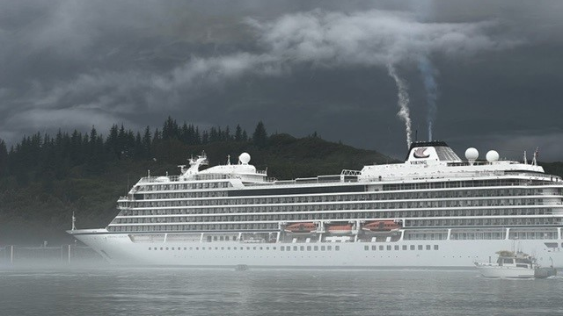
AK DEC Marine Water Quality Monitoring and EVOS Lingering Oil
PWS Natural History Symposium
May 16, 2023
Maryann Fidel

Slide 2
Overview
Marine Water Quality Monitoring
EVOS Lingering Oil Project
AK Clean Harbors
Why, where, what and some results

Slide 3
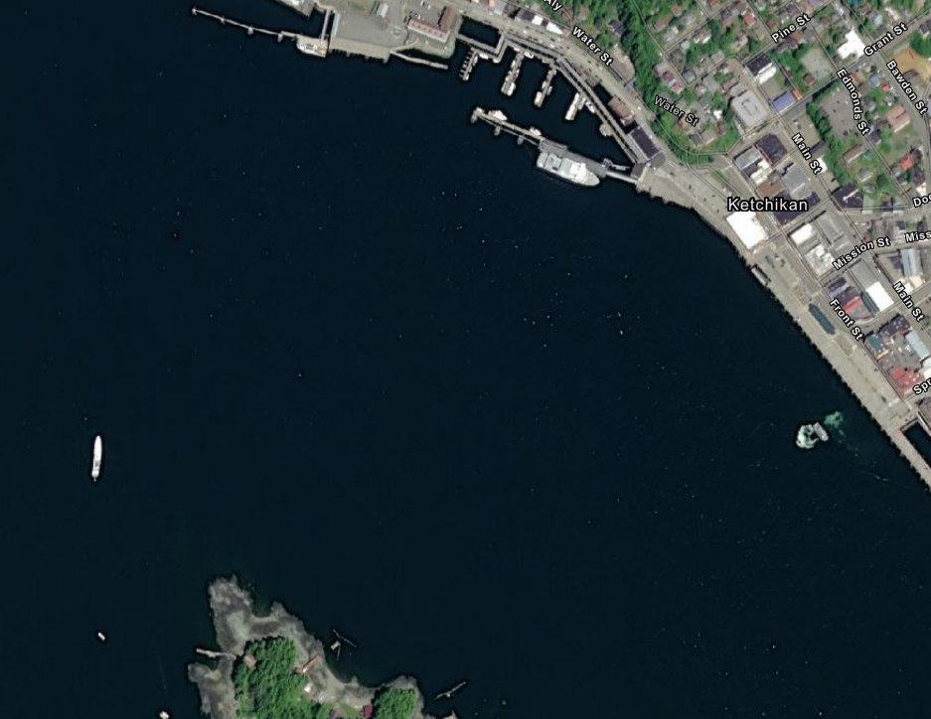
WHY WE MONITOR
DEC’s Mission: To conserve, improve, and protect Alaska's natural resources and environment to enhance the health, safety, and economic and social well-being of Alaskans.
More data about ambient water quality conditions is needed to inform water discharge permits
To ensure marine waters are of quality to support designated uses
Notes:
Program was born out of new regulations for cruise ship discharges that began in the early 2000’s, DEC is charged with permitting and monitoring wastewater discharges from CSs. The SoA also has Water Quality Standards that specify the water quality needed to protect certain uses of that water, such as aquaculture, recreation, food processing, harvesting raw shellfish; the necessary water quality needed to to support growth of aquatic life. In order to ensure these uses are being attained we need to understand the quality of the receiving waters to make sure discharges aren’t exceeding water quality standards, in order to protect human health and the environment.
Mixing zones map shows about how big these mixing zones are. Two types: over 6 knots 60 m X 5 m; > 6 knots = 83 m; Skagway has their own due to the shape of the bay, and potential for overlap 15 m
Uses for marine waters include:
Class (2)(A) – Water Supply: drinking, culinary, and food processing; agriculture; aquaculture; industry
Class (2)(b) – Recreation: Contact; secondary
Class (2)(c) – Growth and propagation of fish, shellfish, other aquatic life and wildlife
Class (2)(d) – Harvesting for consumption (marine only) – usually the most strict

Slide 4
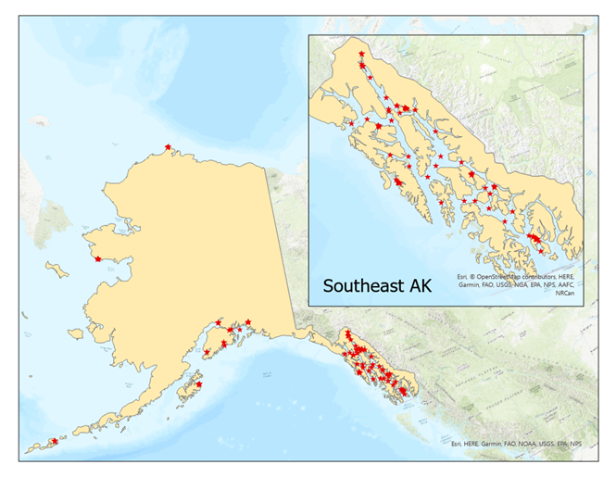
Where
Anchorage
Auke Bay
Dutch Harbor
Haines
Homer
Hoonah
Juneau
Ketchikan
Kodiak
Nome
Petersburg
Seward
Sitka
Skagway
Utqiagvik
Valdez
Ward Cove
Whittier
Wrangell
Select Shipping Lanes
Notes:
These are the harbor where monitoring is occurring; they are the larger ones, and they receive Cruise ships; 150 sample sites

Slide 5
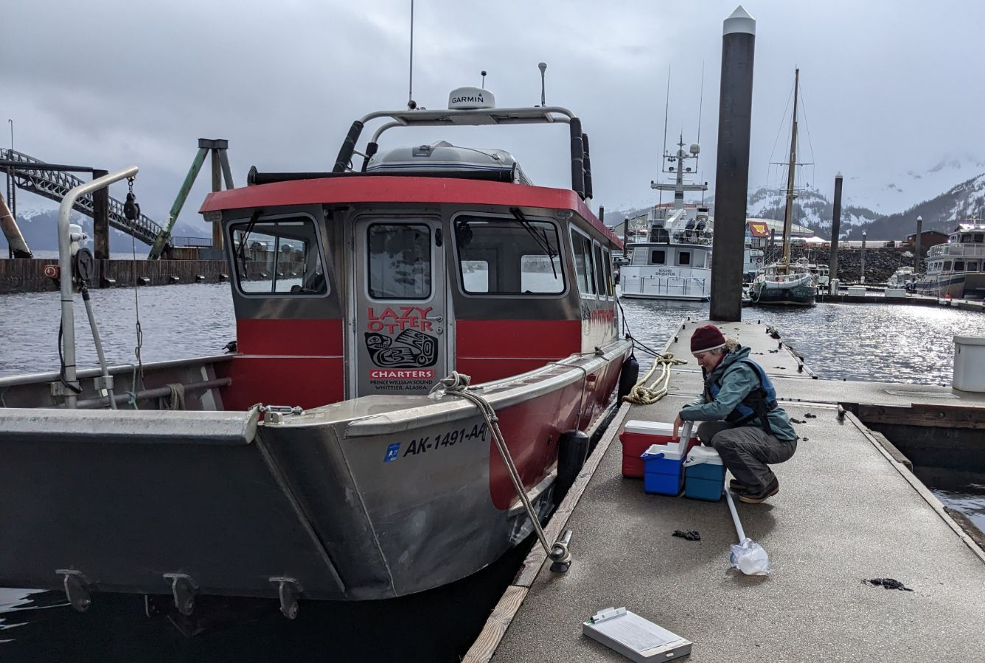
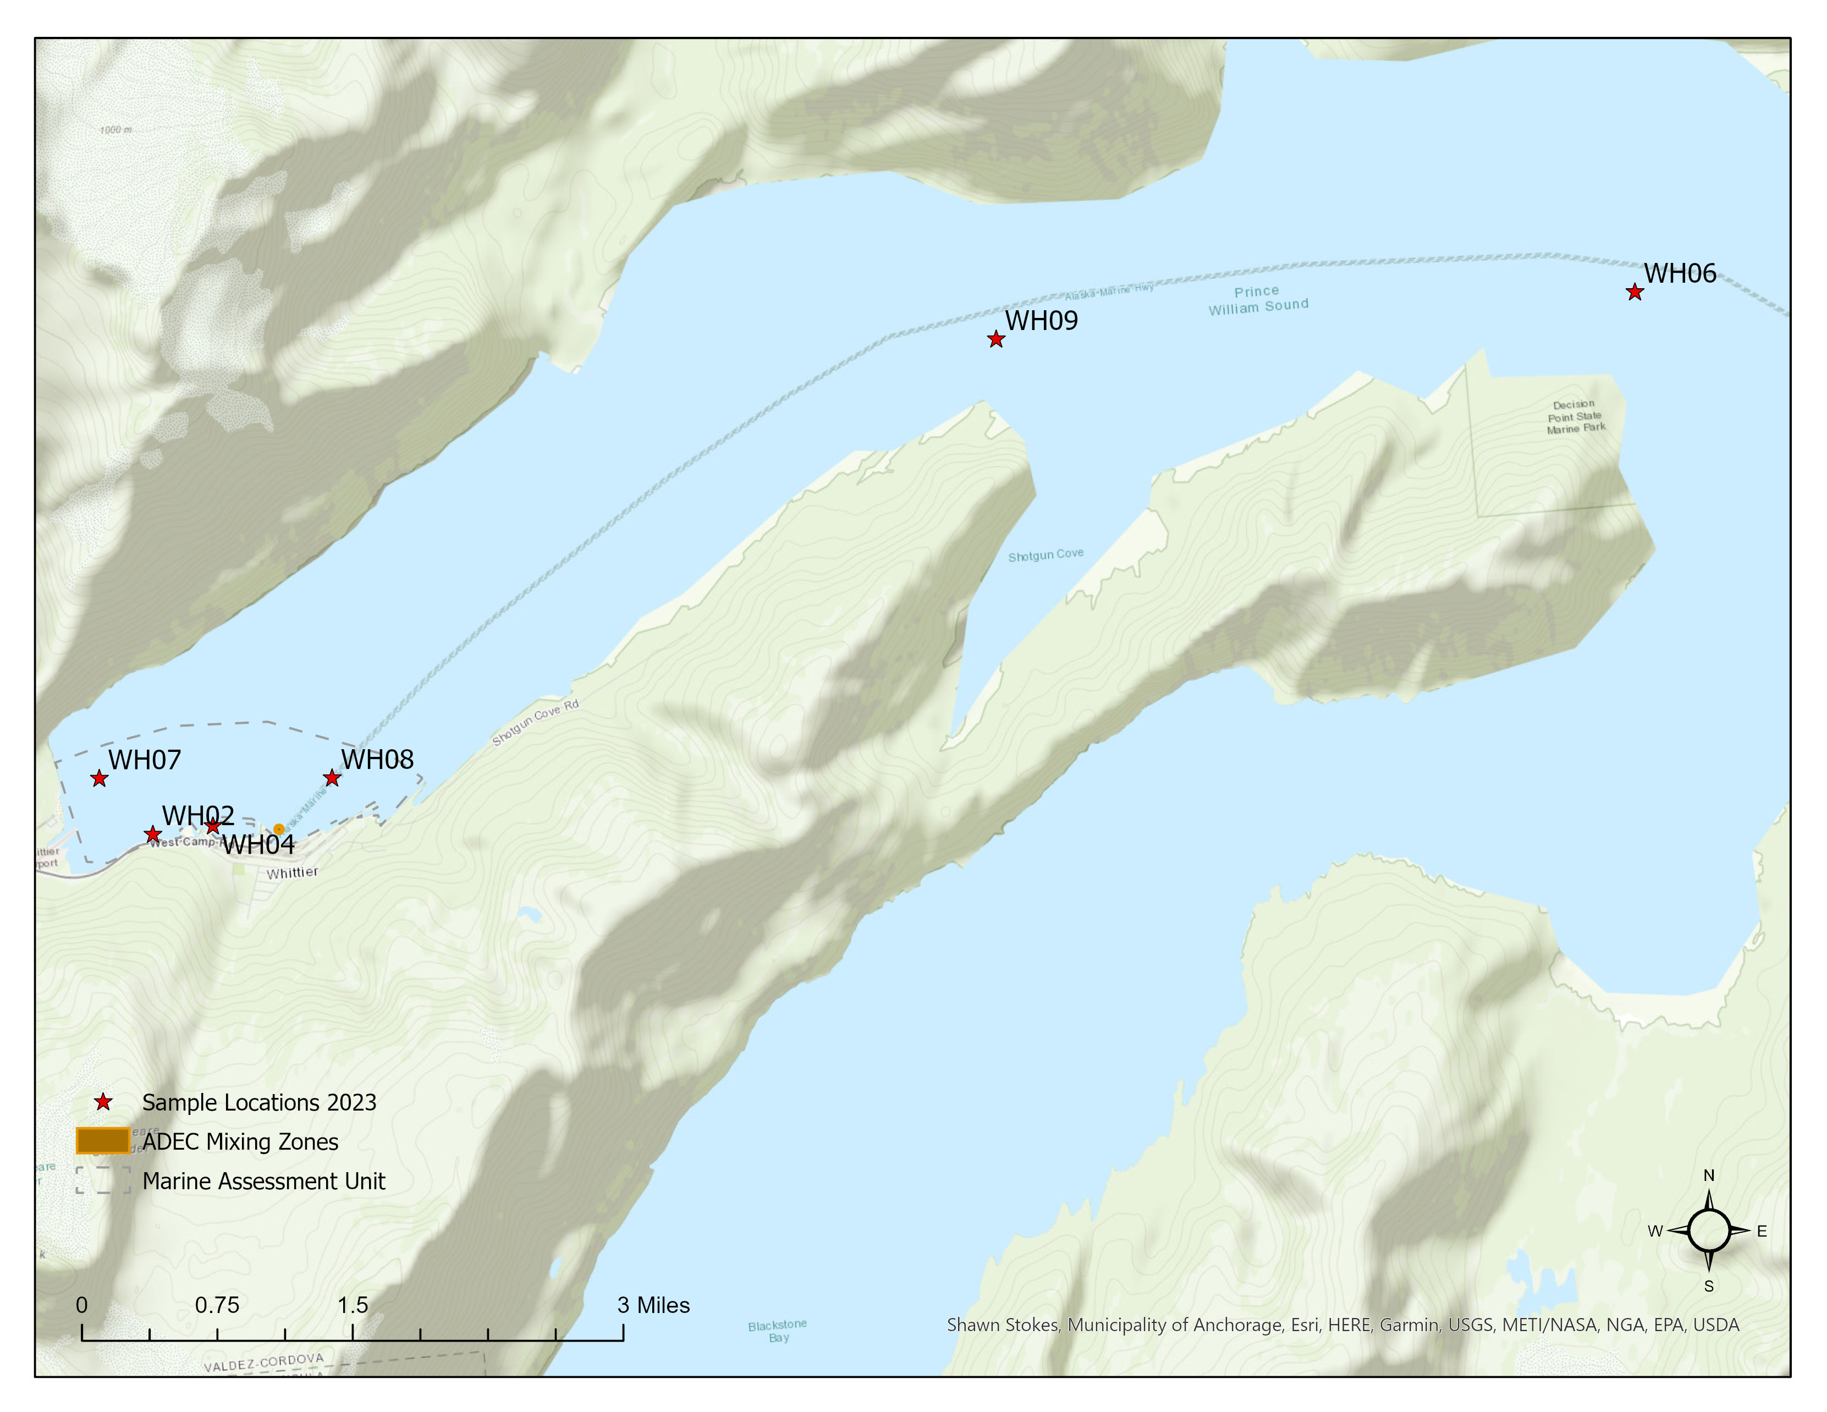
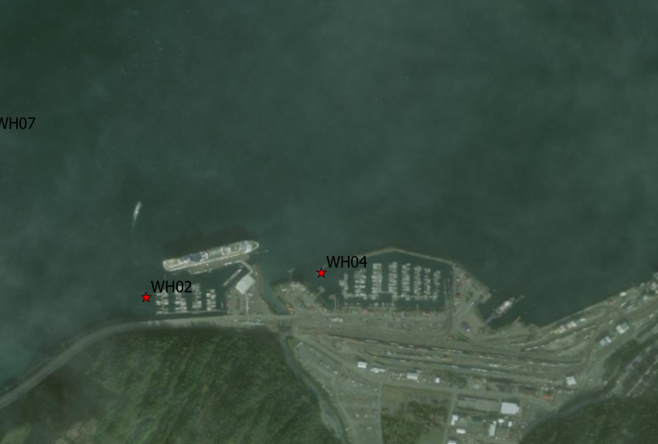
Notes:
Near each community is 4 – 10 sample sites, here are the sample sites near Whittier. Past Whittier samples were relatively clean, but we are continuing to sample here to establish a good baseline before expected increase in cruise ship traffic.

Slide 6
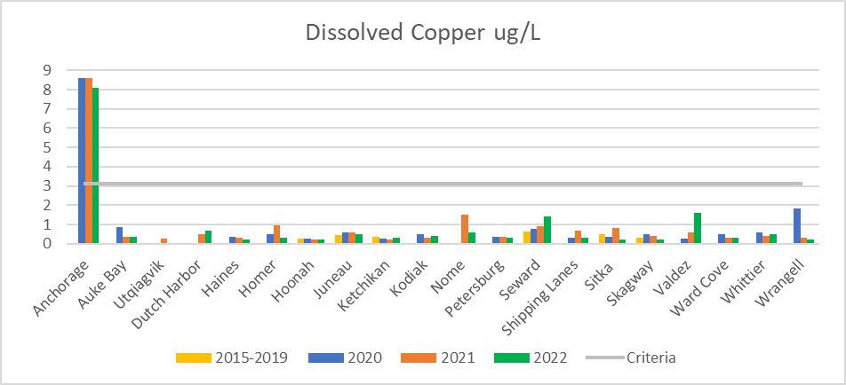
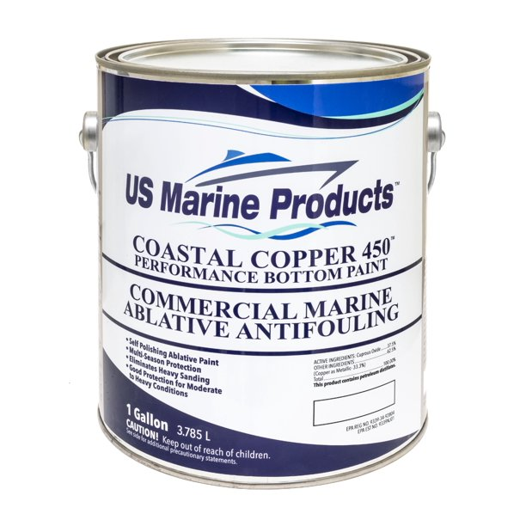
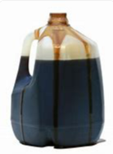
Provisional Results
Data collected in 2015 - 2019
Notes:
The data from 2022 is at this point in time ‘provisional’ meaning it has not gone through QA/QC checks; the QA/QC-ed data will be published in a final report by next fall.
What we monitor was selected because they are the most likely pollutants to be discharged by vessel wastewater that do not meet WQS at end of pipe, based on past compliance reports.
This line represents the strictest of the criteria for this particular pollutant – as you can see most/all results fall below this concentration.
For past 3 years all sites were sampled once for metals, the 2015 – 19 data sampling was less, see the star by those places that were sampled during those years. But remember 2 years of 2 years of COVID where there were no CS was 2020 and 2021; in 2022 CS were back to near normal numbers; so looking at these data pay attention to differences there.
Sources: additional sources include: Cu is used in anti fouling paints to prevent algae growth (algaecide), anti microbial properties that kill bacteria, viruses and yeasts on contact, from weathering rocks, burning fossil fuels, used motor oil
Impacts: Toxic to marine life, does bio-concentrate, Humans need some Cu, but too much causes negative health impacts, such as damage to the kidneys and liver, could lead to death
With all metals Anchorage has high amounts of naturally occurring metals that travel along with the huge amount of glacier silt that goes into Cook Inlet

Slide 7
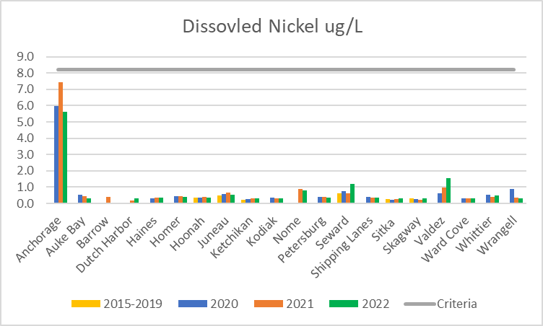
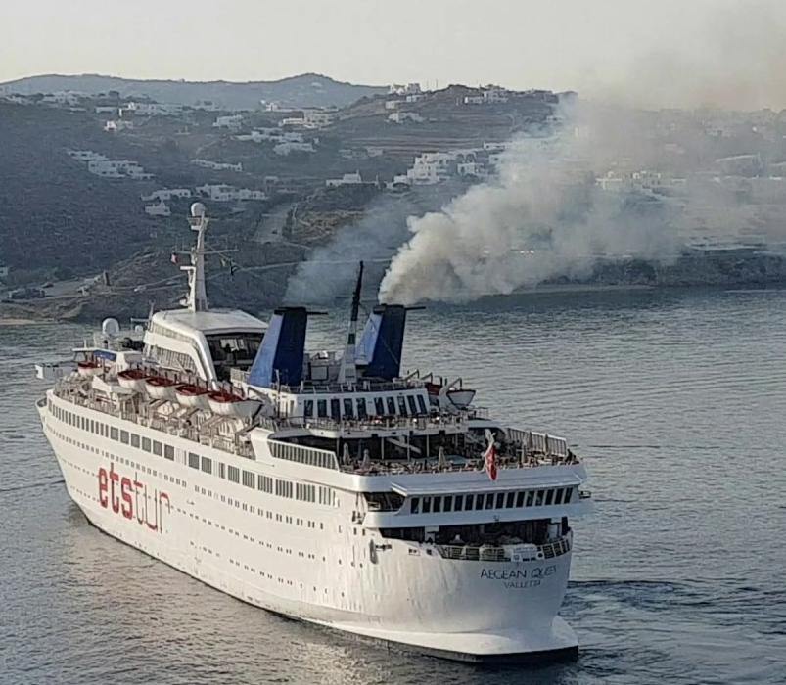

Provisional results
Notes:
Sources: Ni naturally from weathering rocks, but also from burning of fossil fuels, municipal and industrial waste; resistant for corrosion, propeller shafts; we pass small amounts through our bodies
Impacts: Harms cell membranes especially in the gills of fish, can bioaccumulate in tissues, so could be harmful to people who eat fish that are exposed to high levels of Ni; links to a variety of negative health effects (allergy, cardiovascular and kidney disease, lung and nasal cancer, neurological problem, developmental issues in children)

Slide 8
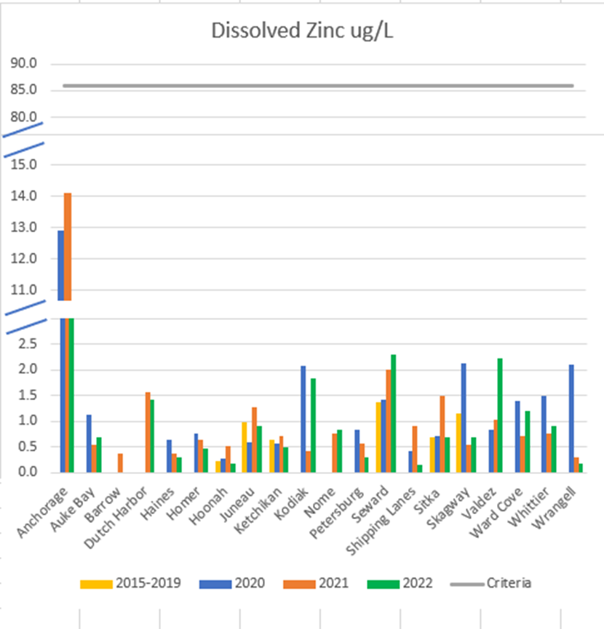
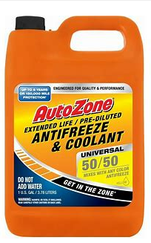
Provisional Results
Notes:
Sources: Elevated levels of zinc in harbor sediments have been found associated with boat operation and maintenance, Zn in antifreeze, and antifouling paints, wood preservatives and fertilizers, used in galvanizing (coating steel products for weather resistance), has anti corrosive properties
Impacts: Zinc, in high concentrations, can be toxic to marine life, and can be potentially toxic to humans who eat contaminated shellfish or fish; can cause genetic defects, neurological problem, organ damage; one of the most mobile heavy metals; humans need some Zn

Slide 9
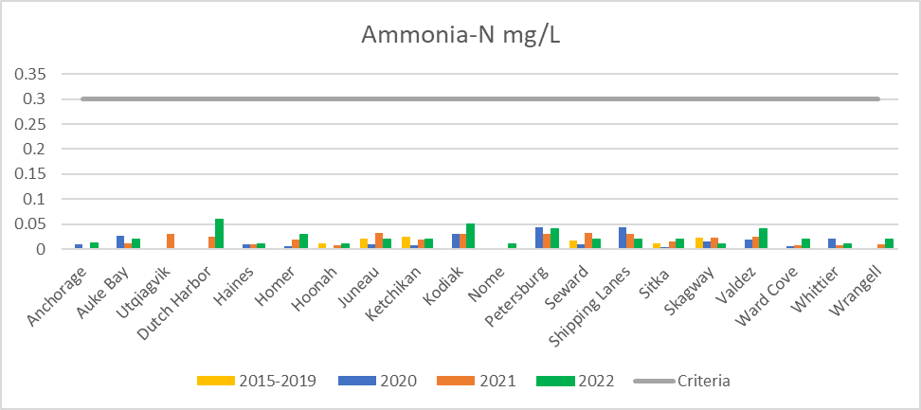
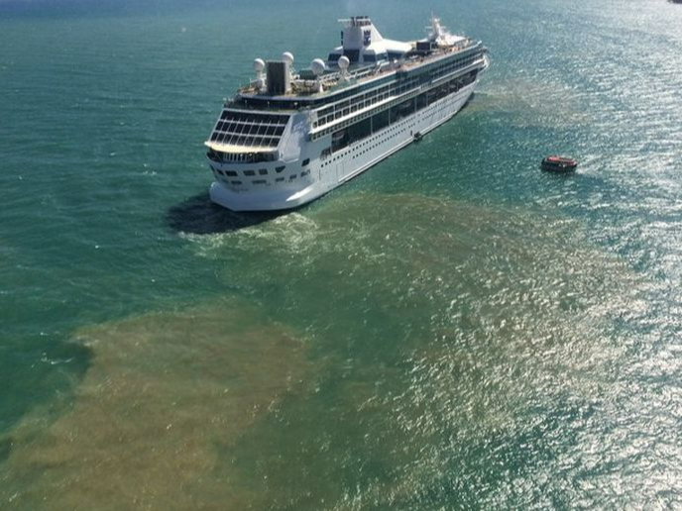
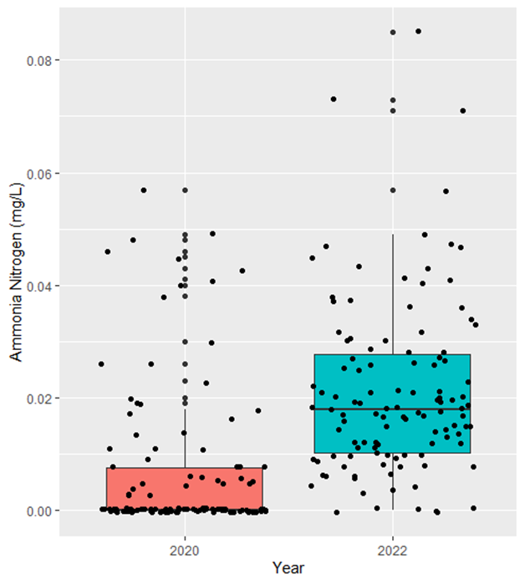
Provisional results
Notes:
Sources: NH4NO3 is from sewage, fertilizers, refrigerant and solvents.
Impacts: At high levels, high temps and high pH, this can be toxic to marine life (common cause of fish kills), can also lead to low DO and eutrophication; for humans causes lung irritation, high exposure can cause fluid build up in lungs and death; irritation of eyes, nose, mouth and throat;
A statistical t-test compared ammonia as nitrogen among COVID years where there was very little cruise ship activity (2020-21), and 2022 when cruise ship activity was at near normal levels. The mean value of ammonia-N for years without cruise ships (.01179) was significantly lower than the mean in 2022 (.02113); t(222.57) = [5.32], p = [.0000002566] (see figure 6).
Results are still well below water quality criteria, so while the differences aren’t concerning, ammonia as nitrogen may be an excellent indicator to track discharges.

Slide 10
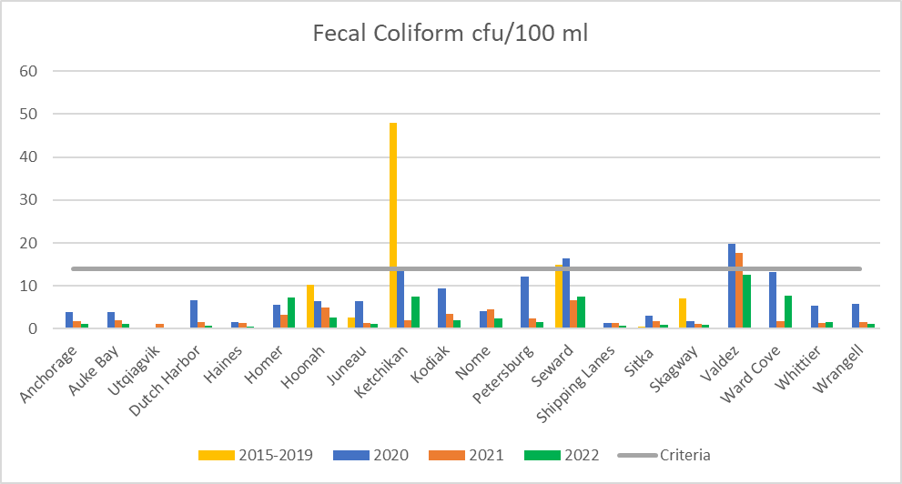
Notes:
Indicator of sewage, found in the digestive track of warm blooded animals. Is an indicator of pathogens (such as E. coli) that cause illness (rash, ear infections, gastrointestinal pain, nausea, diarrhea, vomiting and fever), and can lead to low Dissolved Oxegen.
Sites near communities (not shipping lane sites) were sampled 5 times for bacteria (FC and enterococci), the geo mean is taken of the average, so most years about 30 samples.

Slide 11
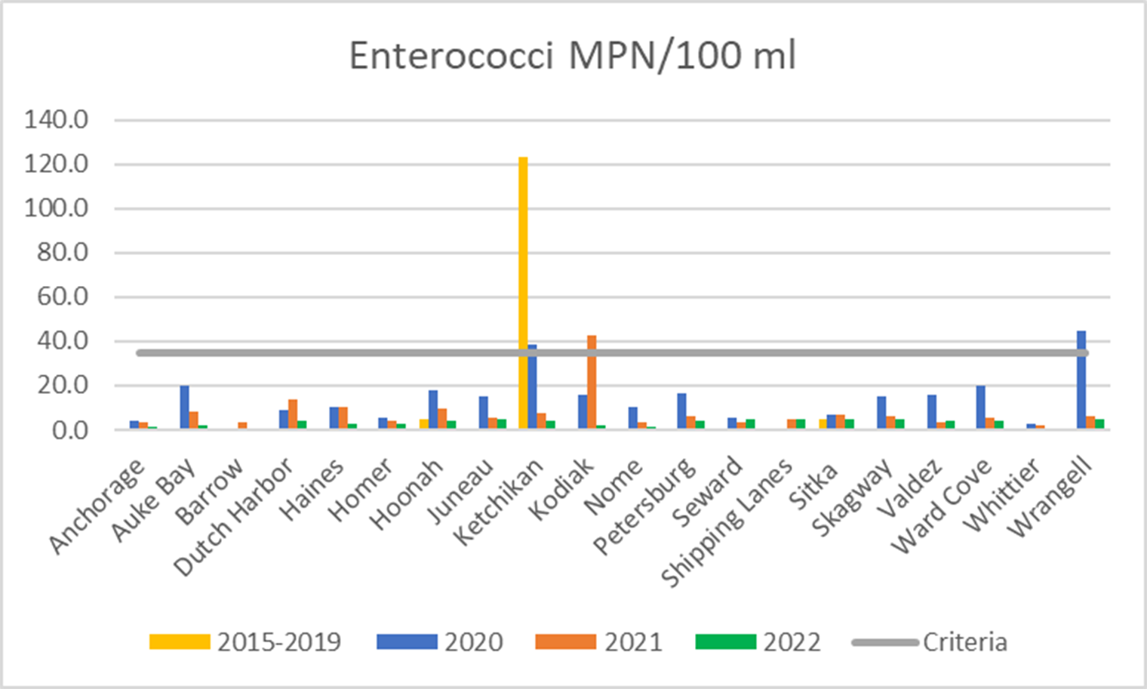
Notes:
Enterococci are distinguished by their ability to survive in salt water, and in this respect they more closely mimic many pathogens than do the other indicators. While this doesn’t directly cause illness it is an indicator of waste from warm blooded animals, which can cause illness. High levels also can reduce dissolved oxegen which causes problems marine life. This is a better indicator of human waste in marine waters than FC. Entero lives longer than FC in the marine environment.
In addition to these parameters we are documenting physical parameters, to better understand environmental conditions, including temperature, pH, salinity, and dissolved oxegen.

Slide 12
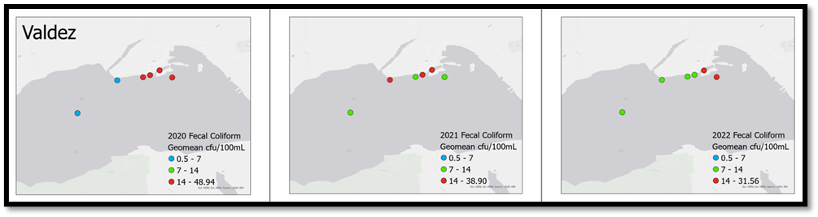
Notes:
There were pathogen exceedances in Seward, Ketchikan, Kodiak and Wrangell; will use Microbial Source tracking this year to better understand sources of pathogens

Slide 13
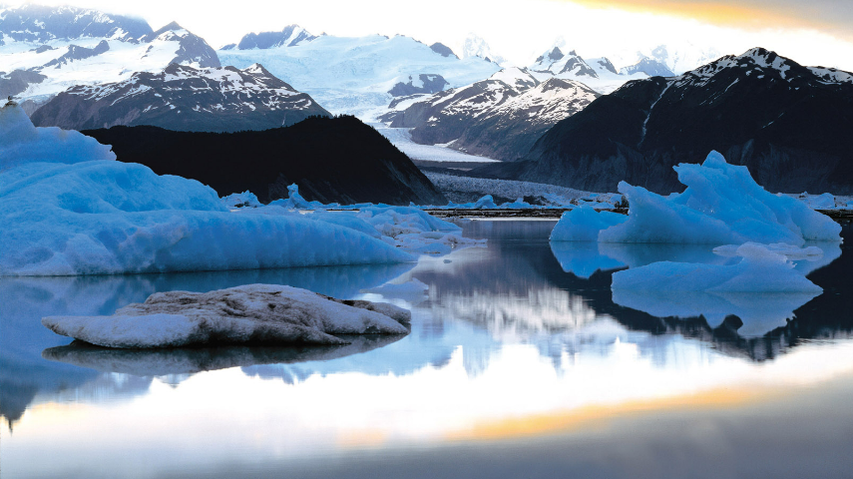
summary
Generally, Alaska’s marine water quality is excellent
Provisional data shows some bacteria pollution near communities and especially near harbors
Although cruise ships likely have some impact, the data does not show obvious differences between low and high vessel years
Need more sampling to understand impacts of sewage discharges, pinpoint the problem and work toward solutions
Notes:
For all parameters, only the fecal bacterias come close to exceeding criteria, and these samples were taken during the busy summer months. The pathogen data is erradic, need to better understand how often ‘blips’ of high bacterias occur, and when (what seasons)
Shipping lanes generally (but not always) had lower levels of all parameters
No large differences between years with little cruise ship activity, and lots

Slide 14
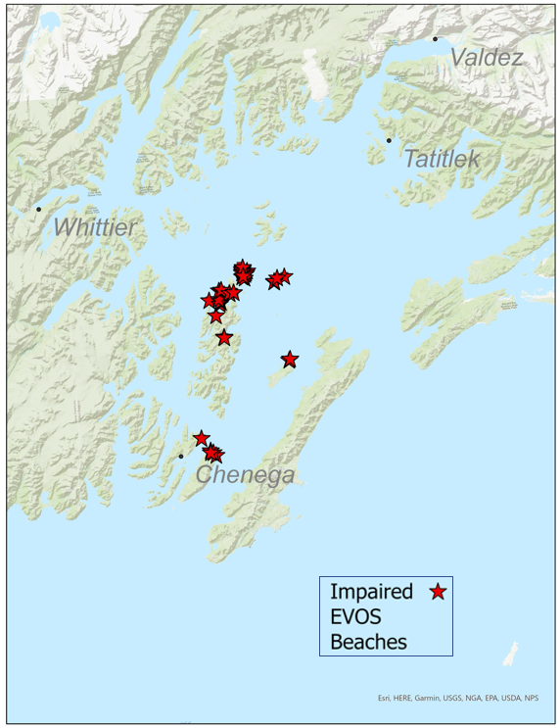
Assessment of EVOS impacted beaches – lingering oil
Working to develop a methodology to assess the status of lingering oil on currently water quality impaired beaches by reviewing existing research, literature and Indigenous Knowledge sources.
This methodology will then be applied to EVOS impacted beaches with lingering oil and their status will be updated (as impaired or attaining).
This will be a data driven process.
Notes:
Pass around sign up for listserv
a. It's been over 30 years since the spill. And since that devastating spill there has been lots of research looking at the impacts of the EVOS.
In the aftermath of EVOS there were a lot of environmental policy changes including the impaired listing of many EVOS affected beaches. Since then, DEC has further developed tools and processes for assessment. Through this project DEC will develop a process for reassessing EVOS impacted beaches. This process will incorporate more recent data on the bioavailability and toxicity of lingering oil, and current impacts to human use.
DEC is planning to revisit the status of the beaches using DEC’s Integrated Report, which is a biennial update of the status of waters in AK
3. How will a new listing methodology change things? These are best guesses, since it is unknown at this point whether the status of beaches will change, and no one can predict the future.
i. DEC permitting: currently the impaired status of EVOS affected beaches doesn’t affect any permits because of the remote nature of these beaches. If there was a development that required a discharge permit for hydrocarbons (like a fuel dock, or other development that would require fuel storage) it would likely be easier to get if the beaches are not impaired
ii. Resource allocation: If beaches are no longer impaired likely funding for research at these beaches would decrease and shift to more urgent priorities

Slide 15
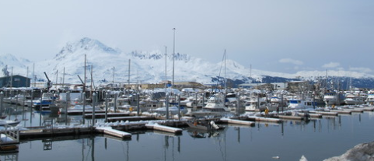
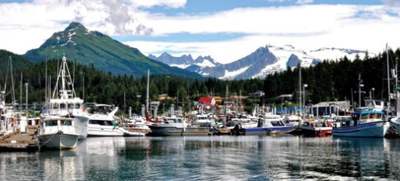
Alaska Clean Harbors
A voluntary, non-regulatory program working throughout the state to help harbormasters, communities and boaters prevent pollution and reduce waste in our harbors and waterways.
Working with SeaGrant to revitalize the program
http://www.alaskacleanharbors.org/

Slide 16
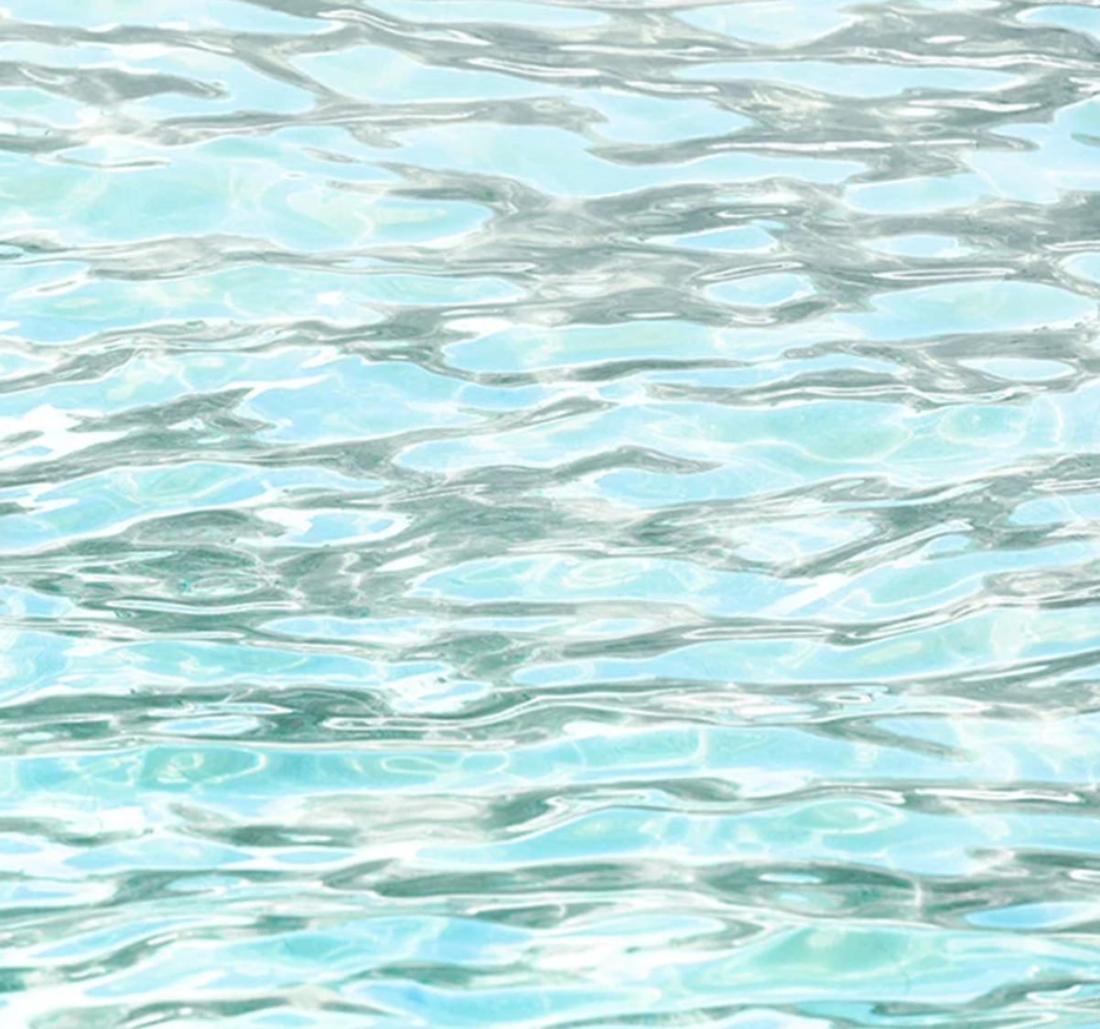
MORE INFORMATION
Compliance Information:
https://dec.alaska.gov/water/cruise-ships/
Monitoring:
https://dec.alaska.gov/water/water-quality/monitoring-and-assessment/watershed-health-and-data-analysis/ambient-marine-water-quality-monitoring
Any questions or input/advice?
My contact: maryann.fidel@alaska.gov

