Slide 1
THE TATITLEK CORPORATION
CELEBRATING 50 YEARS

Slide 2
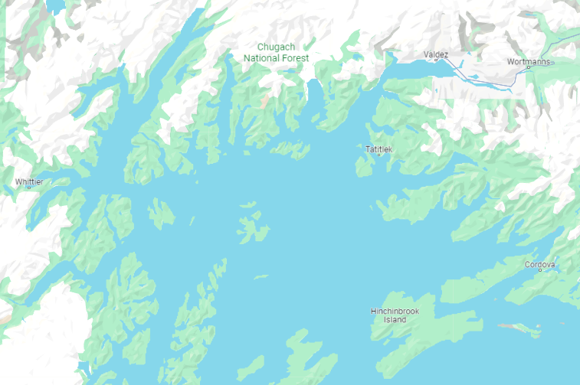
tatitlek

Slide 3
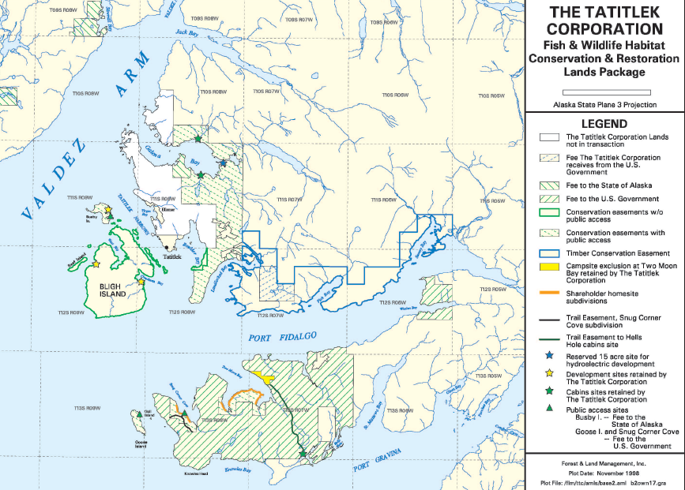
TATITLEK LANDS

Slide 4
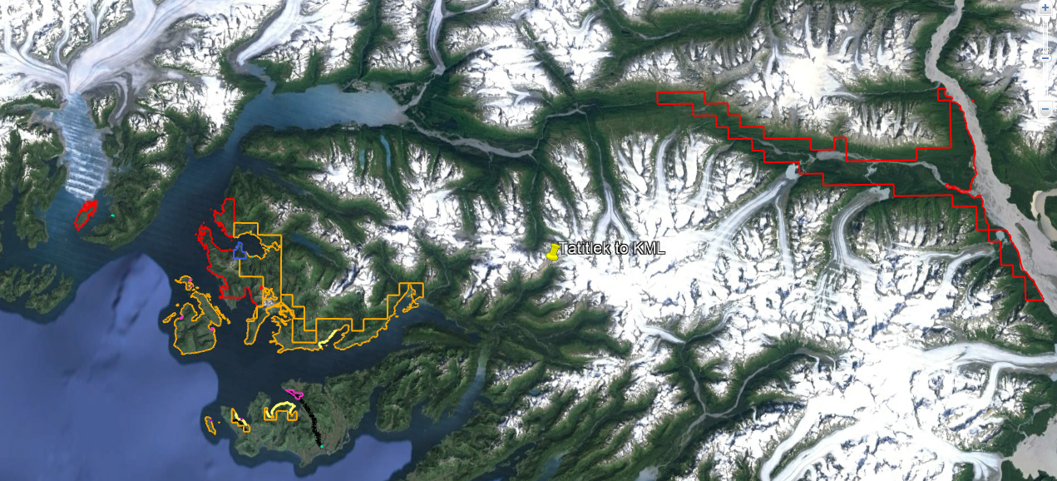
TATITLEK LANDS

Slide 5
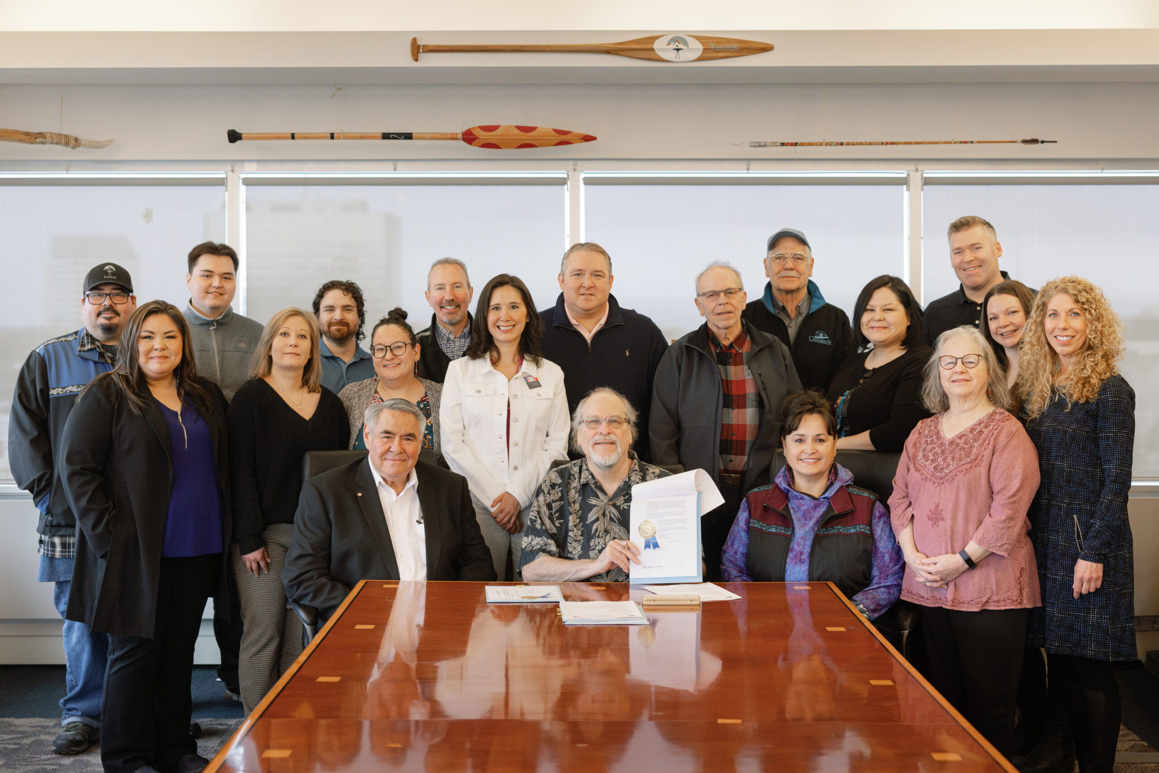
TATITLEK LANDS
Final
Conveyance
complete

Slide 6
TATITLEK LANDS
Tatitlek’s strategy for its lands can currently be summarized with one word:
CONSERVATION
Economic objectives are also a factor, but there are conservation actions that can also create economic benefits, such as carbon credit, timber conservation agreements for NOL, etc.
These actions are those in which Tatitlek has engaged, or are currently under consideration
Permits are required for anyone other than shareholders to access Tatitlek lands

Slide 7
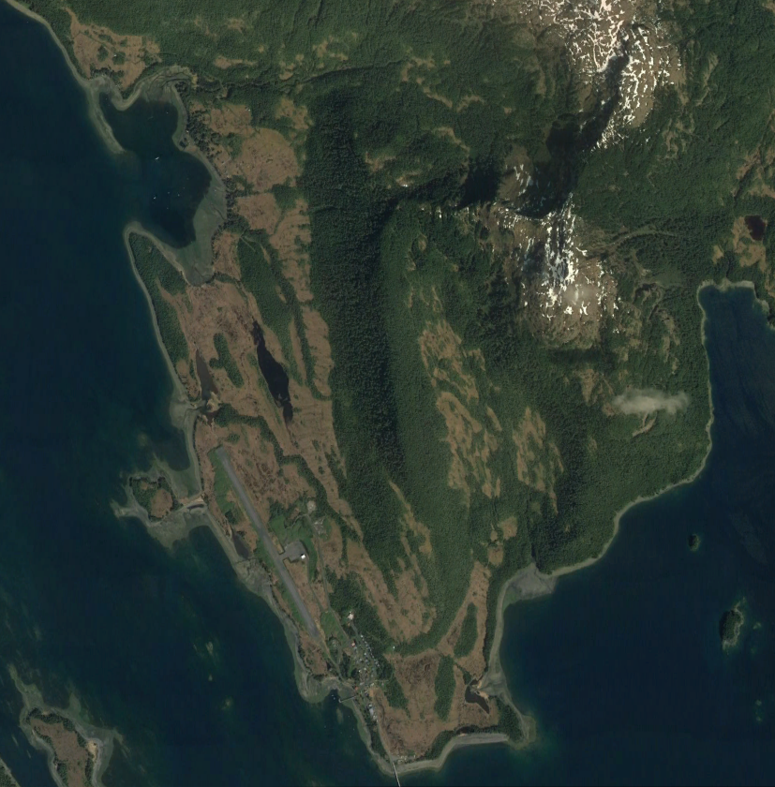
Current projects
Ellamar
Previous village site was at natural bay, Virgin Bay
Copper surface outcropping discovered around 1897 by mining prospectors. They filed mining patent and forced villagers to move. After mining ceased, land was eventually subidivided. EVOS interrupted development, and Tatitlek bought/repatriated most parcels in 2018-19.
Standing offer still open to other owners in Ellamar to sell to Tatitlek

Slide 8
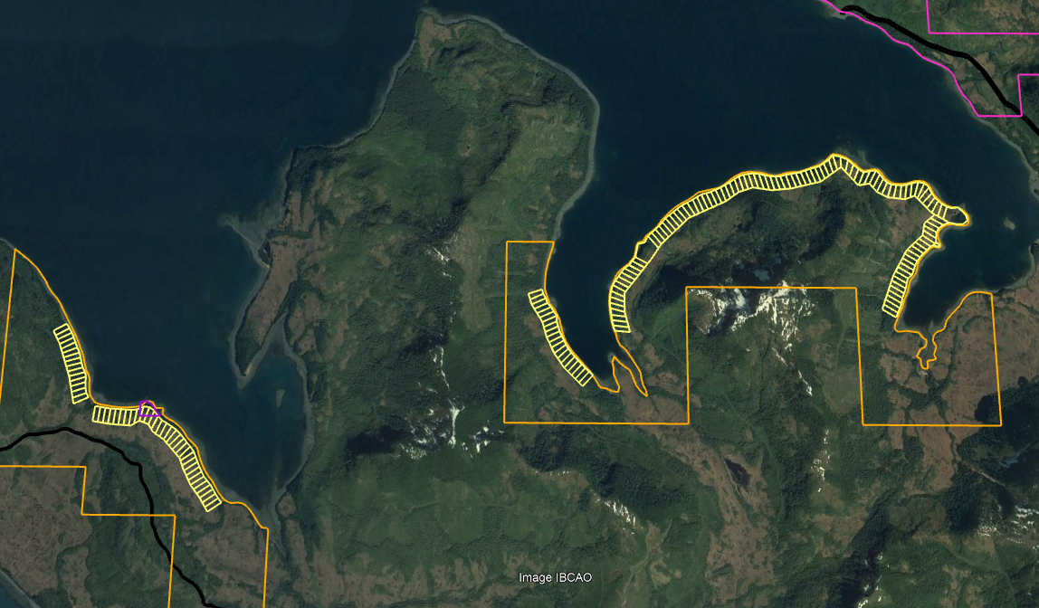
Current projects
Shareholder homesite program
Lands on coast of Port Fidalgo subdivided at Two Moon Bay, Fish Bay, and Snug Corner Cove
Originally conveyed to shareholders with offer to repurchase
Offer to repurchase recently renewed

Slide 9
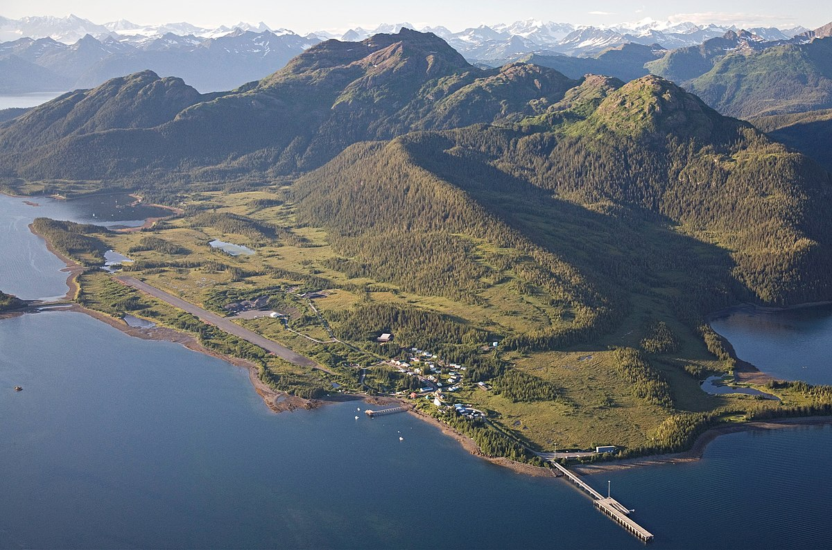
Current projects
In progress in the village
Upgrade to electrical generation and grid in the village of Tatitlek
Other cost benefit analyses and studies underway to improve village infrastructure
20th annual Peksulineq Cultural Heritage event took place just last week
Breakwater and small boat harbor needed

